Slide 1


The Facts and Economic Impacts of the US-China Trade War
National School of Development
Sifan XUE
CCER, NSD, PKU
Feb. 27, 2025

Slide 2
China-US Trade

Slide 3
The “China Shock”
Dubbed by the the literature for China’s trade expansion
Manufacturing sector employment in the United States has been falling steadily since the 1960s.
From 2000 to 2008, the period of the China shock, manufacturing sector employment fell even more rapidly.
Research studying the economic consequences of the China shock on the US economy finds that a part of the employment loss in manufacturing was a consequence of China’s trade expansion, which itself was due to either changes in trade policy or changes in productivity in China.

Slide 4
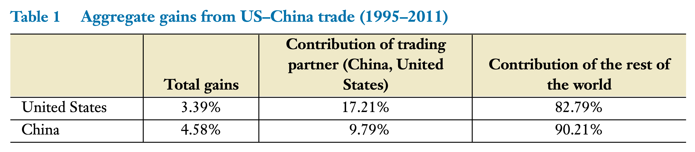
Aggregate Gains from Trade are Widely Agreed upon by Trade Economists
Source: Caliendo and Parro (2023)

Slide 5
Distributional Effects
Autor, Dorn, and Hanson (2013):
Local labor markets that were more exposed to the China shock experienced a larger decline in the manufacturing employment share of the working-age population relative to labor markets that were less exposed.
Suppose that the least exposed CZ was not affected by the China shock. The actual import exposure increased by $1,839 per worker between 2000 and 2007, which implies that US manufacturing employment per population fell by 1.1 percentage points, or approximately 55% of the observed decline in manufacturing employment, during the period.
Caliendo, Dvorkin, and Parro (2019): 0.36 percentage points

Slide 6
Other Effects
Nonmanufacturing employment: positively affected
Innovation: very mixed
Welfare:
Galle et al. (2022) find that a modest but nonnegligible number of groups representing 15.9% of the population suffer welfare losses and that those losses can be up to five times as great as the average gains. The authors find that in the aggregate the China shock increases US welfare by 0.22%.
The findings of the distributional effects of the China shock are economically relevant and have influenced US–China trade relations, e.g., attitude toward globalization and on political outcomes.
Autor et al. (2020): a shift to the right in media-viewing habits and political beliefs, more competitive congressional elections, greater polarization in the ideological orientation of campaign contributors, and net gains in the number of conservative Republican representatives.

Slide 7
The 2018–2019 Trade War
Somewhat unprecedented tariff changes in terms of the scope and magnitude
The United States largely targeted China, raising tariffs on thousands of products from China, targeting roughly $350 billion of imports from China.
In response to these tariff increases, China retaliated over several tariff waves, targeting about $100 billion of US exports
Many quantitative research on the effects of trade protectionism driven by this trade war.

Slide 8
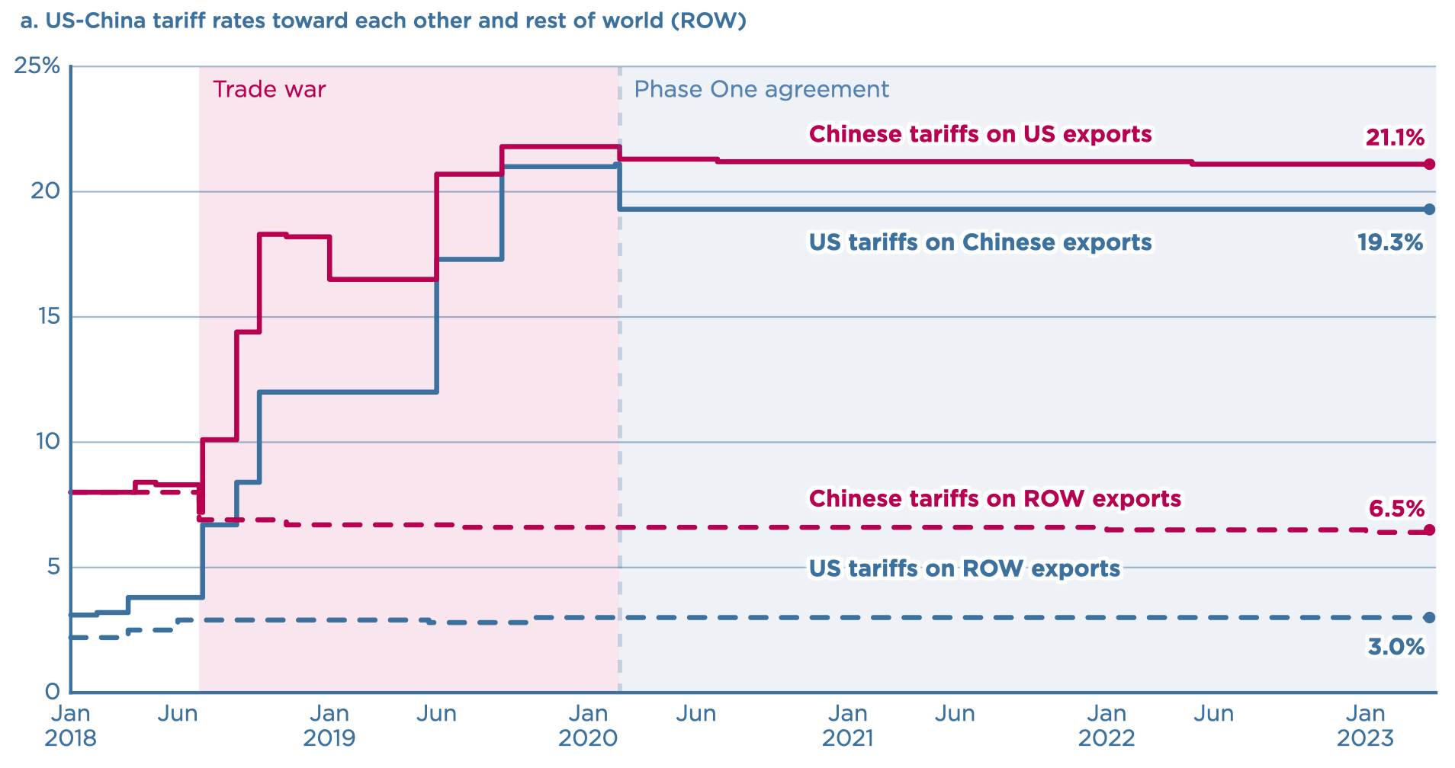
US-China Trade War Tariffs: A to-be-Update Chart
Source: Chad Bown PIIE Website Articles

Slide 9
Complete Pass-through
Amiti et al. (2019), Fajgelbaum et al. (2019), Cavallo et al. (2021).
Estimate the effects of the trade war on US prices and quantities. Find that the tariff changes were almost entirely passed through to domestic prices, leaving relative export prices unchanged.
Notes:
Does not imply that the relative price of imports to exports is unchanged. For instance, changes in the level of exports to the United States may still be associated with a change in the US wage relative to the wage in all countries, a terms of trade effect that would differentiate out in reduced-form regressions.

Slide 10
Welfare
Caliendo & Parro (2022) find that aggregate US households’ welfare declines 0.1% due to the trade war, and significant distributional effects on welfare across space.
Most states are worse off, with Alabama being the hardest hit, whereas a few southern states, such as Texas, Oklahoma, and Arkansas; New Mexico in the Southwest; and Washington, Idaho, and Oregon in the Northwest are slightly better off.
Find persistent effects of the trade war on employment and wages across locations.

Slide 11
Has the 2018–2019 Trade War Reversed the Distributional Effects of the China Shock?
Caliendo and Parro (2023): We previously noted that the backlash against US–China trade relations that resulted in the recent trade war was motivated in part by the distributional effects of the China shock and in particular by the employment losses in the manufacturing sector.
To what extent the trade war reversed the distributional effects of the China shock across US labor markets?
The recent trade war generated welfare losses and very small effects on employment and was ineffective in reversing the distributional effects and decline in manufacturing employment due to the China shock.

Slide 12
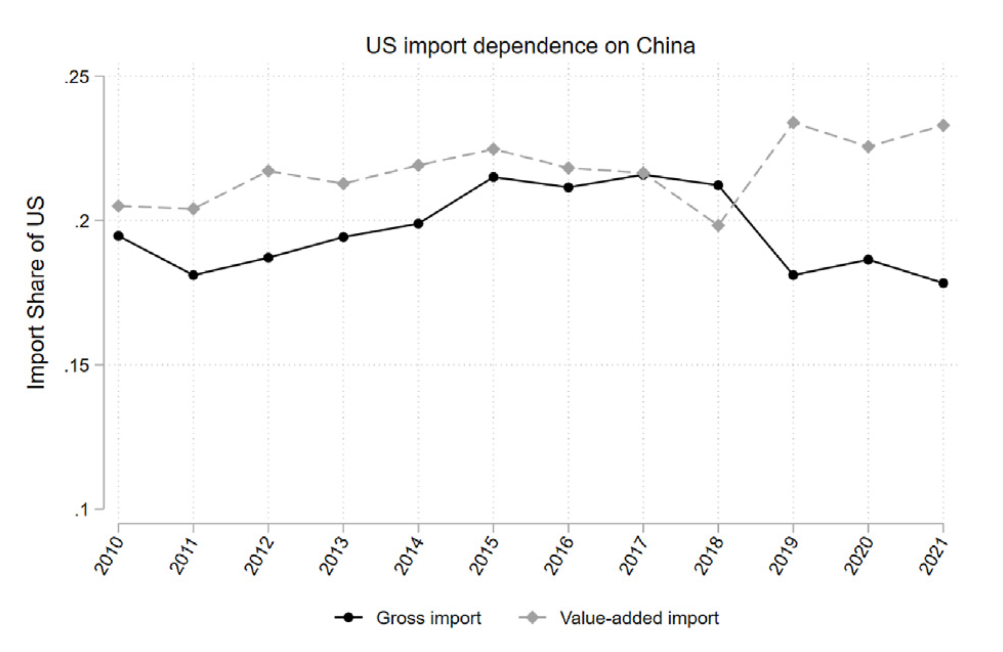
Has the 2018–2019 Trade War Reduced US Supply Chain Dependence on China?
Source: Ma and Ning (2024)

Slide 13

Why Trade War? Does it matter at all?
IPE?
Notes:
Mercantilism, Liberalism, Marxism, Interests & Institution?
Politics?

Slide 14
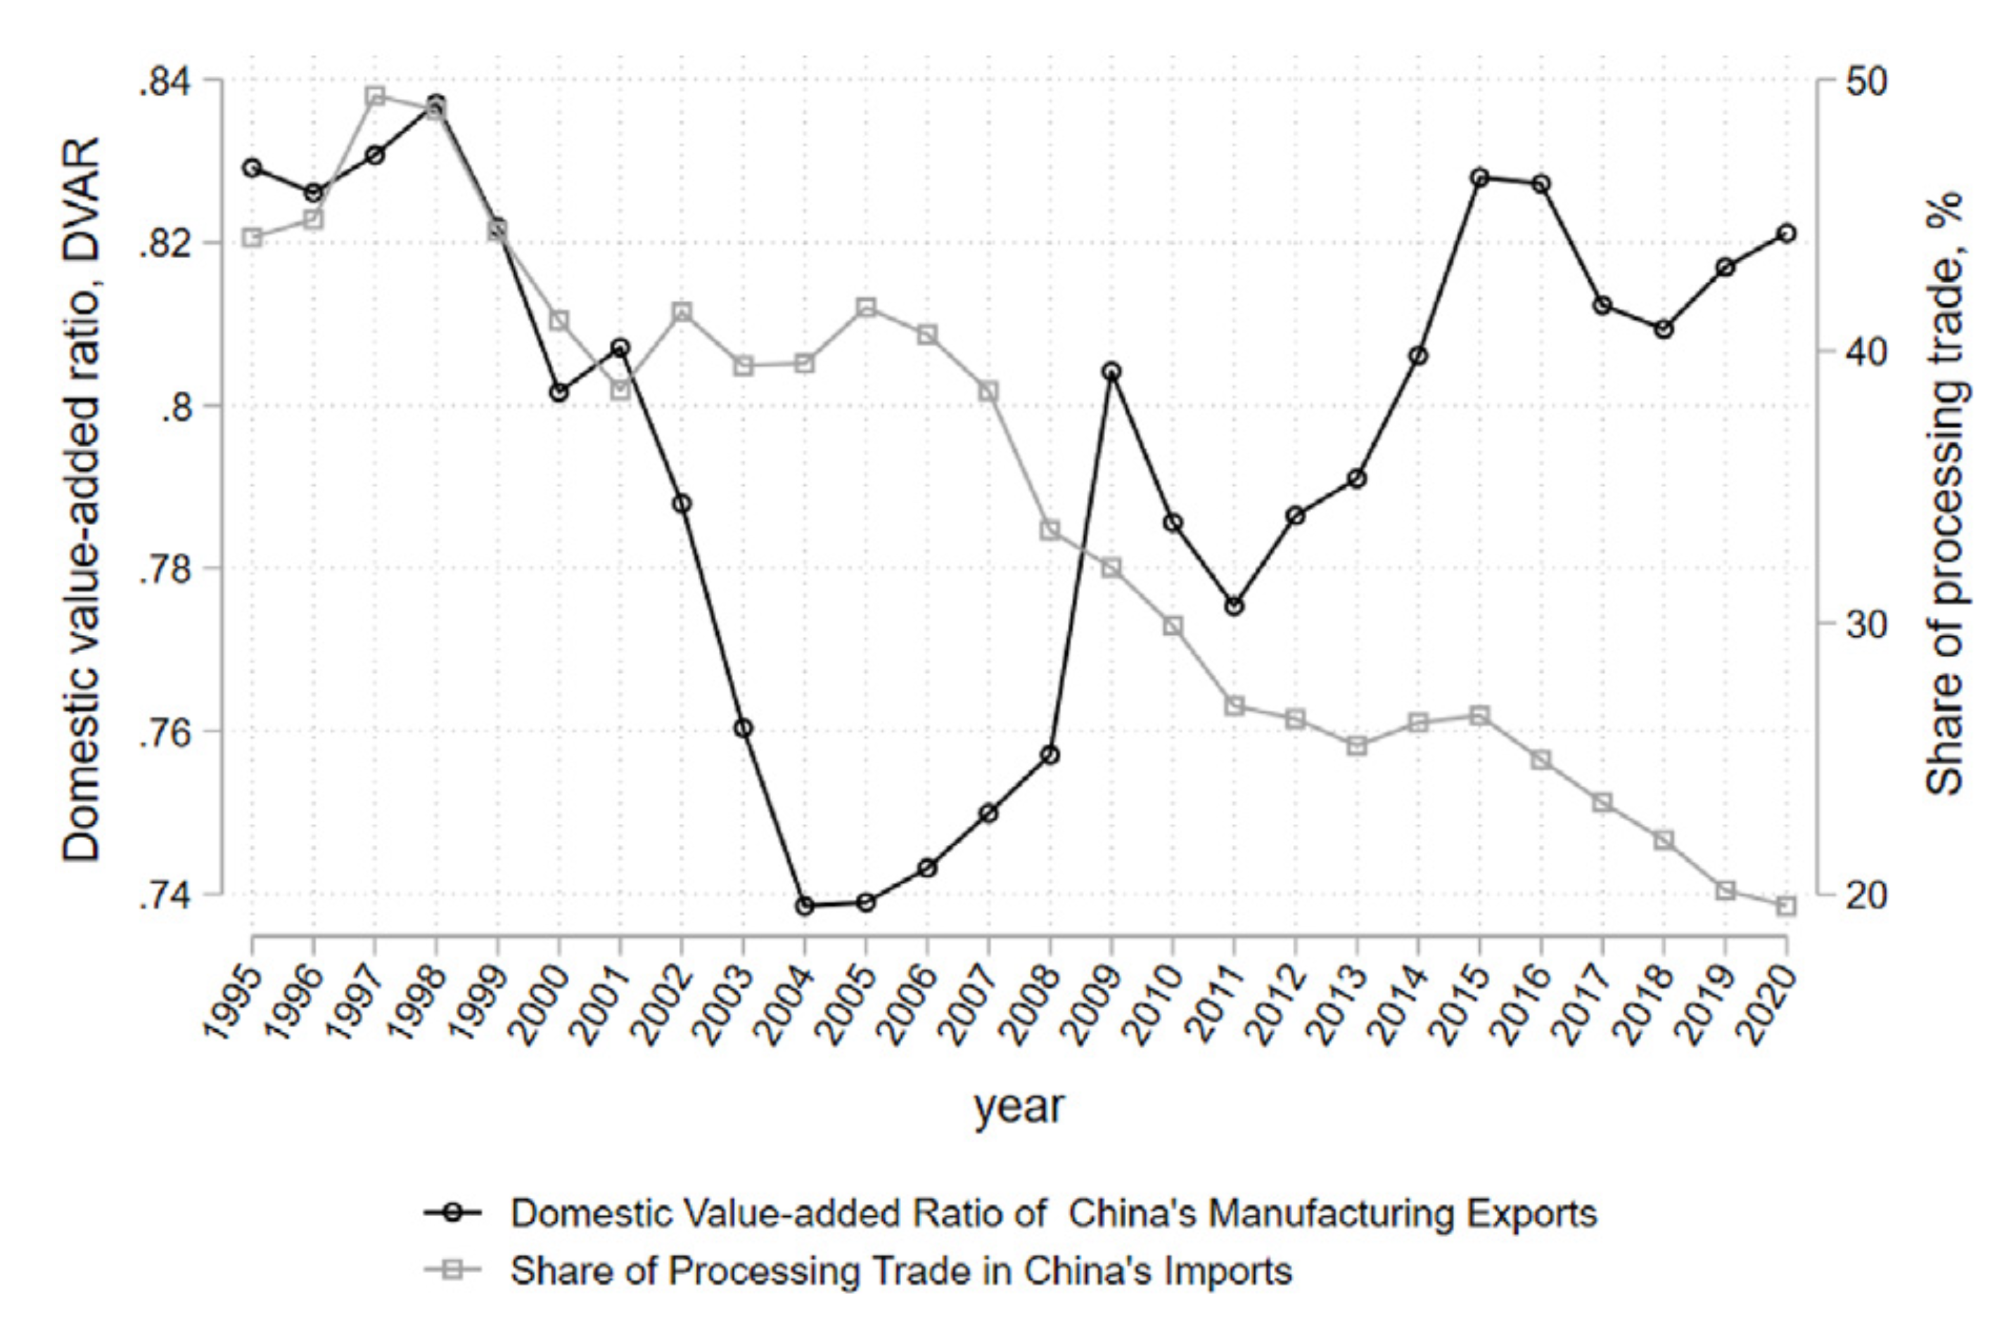
A “Pursued Era” by China
Source: Ma and Ning (2024)

Slide 15
A “Pursued Era” by China
Ma and Ning (2024): The production of labor-intensive products from the US, Europe, Japan, and South Korea was transferred to the Chinese mainland due to their rising labor costs, while their comparative advantages in capital-intensive and even technology-intensive manufacturing industries were gradually lost due to the free flow of capital and technology.
For products in which the share of the US in world exports decreased, the share of China increased.
Revealed comparative advantages (RCA) of China's export had been improved in 2000–2017 in the HS-4 products in which the US used to have revealed comparative advantages.

Slide 16
China-US Trade War Product Structure
The “301 tariffs” imposed by the US initially focused on industries related to China’s “Made in China 2025” initiative, such as aerospace, information technology, and auto parts.
Over time, they expanded to cover more industries, including not only high-tech products but also mid- to low-end manufacturing sectors like textiles, apparel, plastics, and rubber.

Slide 17
Tech Competition
Policy Tools | Legal Basis | Implementation | Announcing Time
Entity List | Export Administration Regulations (EAR) (US) Part 744 | The US has included more than 611 organizations, enterprises, and individuals to the Entity List | 2018.8
Government Intervention in Business | 2020 National Export Control Law and relevant laws | Prohibits the sales of products by Huawei, China Mobile, BYD, ZTE, and other companies related to national security concerns | 2018.7
Coordinate with Allies to Decouple with China | National Defense Production Act | Requires ally businesses to cease supplying certain products to Chinese companies like Huawei | 2020.9
“Poison Pill” | 2022 Chips and Science Act and 2022 Inflation Reduction Act | Multinational enterprises that enjoy subsidies under relevant US legislation are prohibited from investing in China. | 2022.8
Technology Blockade |  | Establishes a “Next G” alliance to research 6G technology, restricted to China | 2021.10
Technology Exchange Restriction | Foreign Investment Risk Review Modernization Act and relevant announcements | Prohibits Chinese investment in US enterprises, and restricts exchanges of Chinese technical personnel | 2018.11
Investment Ban | National Emergency State | Restricts investments in China and specific sectors under US and related control | 2023.8

Slide 18
Core Technology, Supply Chain Safety
On November 30, 2022, US Secretary of Commerce Gina M. Raimondo delivered a speech, highlighting that there are three types of technologies that will be particularly important in the next decade:
Computing-related technologies, including microelectronics, quantum information systems, and artificial intelligence;
Biotechnology and biomanufacturing;
Clean energy technologies. “We will continue to take action to protect our advantage and maintain as large a lead as possible in these foundational technologies.”
She emphasized the need to:
Protect US core technologies through strategically updated export control policies and investment screening frameworks.
Reassess investments in key technological areas.
Strengthen protection of critical supply chains, clearly stating the need to relocate the core parts of the supply chain back to the domestic market or to “friendly countries.”

Slide 19
Industrial Policy
Legislative:
The 2022 Inflation Reduction Act: Requires the use of domestically sourced critical minerals and battery components in the production of electric vehicles, and mandates that the “final assembly” of electric vehicles must occur in North America.
The Chips and Science Act: Authorizes $52.7 billion to attract the semiconductor industry back to the US.
US President E.O. 14017: Reviews risks in the supply chains of information and communication technology, defense, energy, agriculture, public health, and transportation industries, and proposes corresponding countermeasures.
US President E.O. 14105: On August 9, 2023, restrictions were imposed on US investments in China in three areas: semiconductors and microelectronics, quantum information technology, and artificial intelligence.
Institutional:
November 15, 2022: The US-China Economic and Security Review Commission released its annual report, recommending the establishment of the Economic and Security Preparedness and Resilience Office to continuously monitor supply chain resilience indices and dependence on China in key sectors.
The Department of Commerce issued the “Strategic Plan: 2022-2026”: This plan highlights the role of the MEP (Manufacturing Extension Partnership) program, which helps small and medium-sized businesses find local suppliers for their supply chains.
January 6, 2023: The US and Japan signed a memorandum to establish a working group to promote human rights and international labor standards in supply chains.

Slide 20
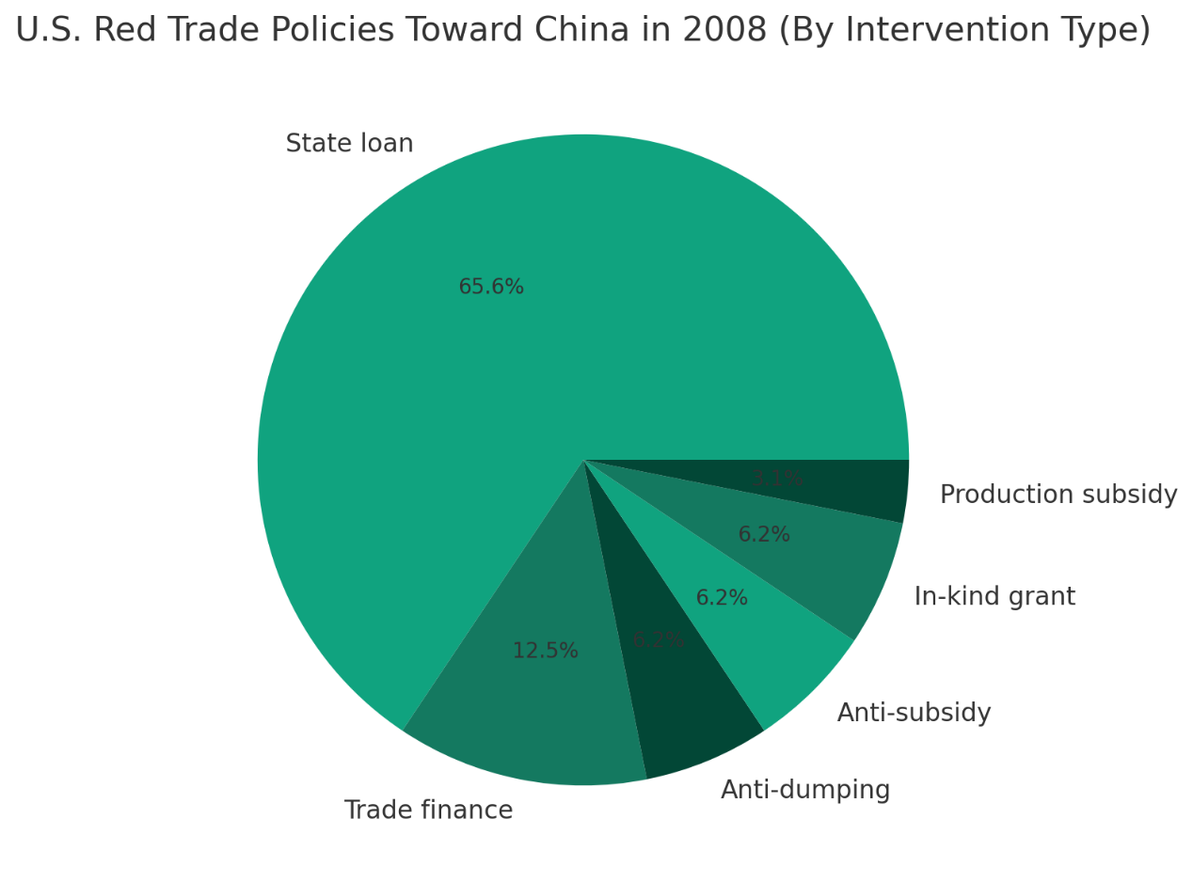
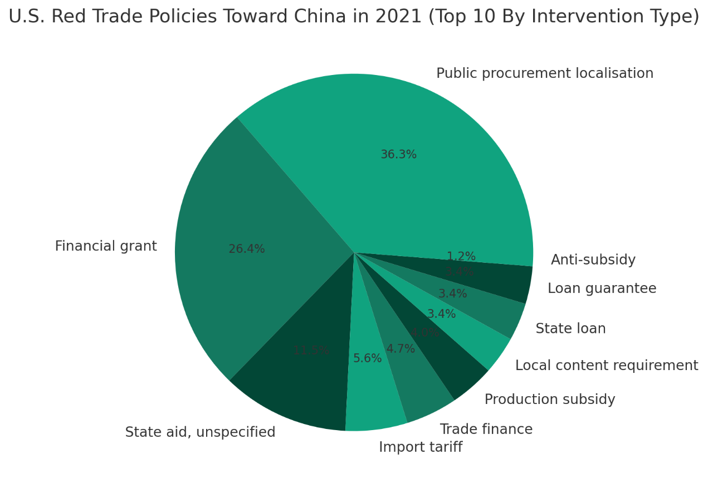
Restrictive Trade Policies
The Global Trade Alert (GTA) database categorizes all trade policy measures into 9 major categories and 56 types.
In 2008, there were only 6 trade policies related to China. By 2021, this number had risen to 16, with the forms of sanctions against China becoming more diverse.
Newly introduced trade measures include: public procurement localization, import tariffs, localization requirements, fiscal subsidies, loan guarantees, and others.

Slide 21
US Manufacturing Reshoring
The growth in US manufacturing output and employment has not been significant, but investment in the manufacturing sector has expanded substantially.
Data Source: US Census Bureau, US Bureau of Labor Statistics

Slide 22
US Manufacturing Reshoring
In manufacturing investment, the computer/electronics/electrical industries dominate, showing a trend of semiconductor industry reshoring.
Figure: US Private Sector Manufacturing Subsector Construction Investment (January 2001 - November 2024, Monthly Data)
Note 1: Data are seasonally adjusted annualized figures, in billions of dollars.
Note 2: Construction spending primarily refers to expenditures related to the construction of buildings, excluding purchases of production equipment, etc.
Data Source: US Census Bureau

Slide 23
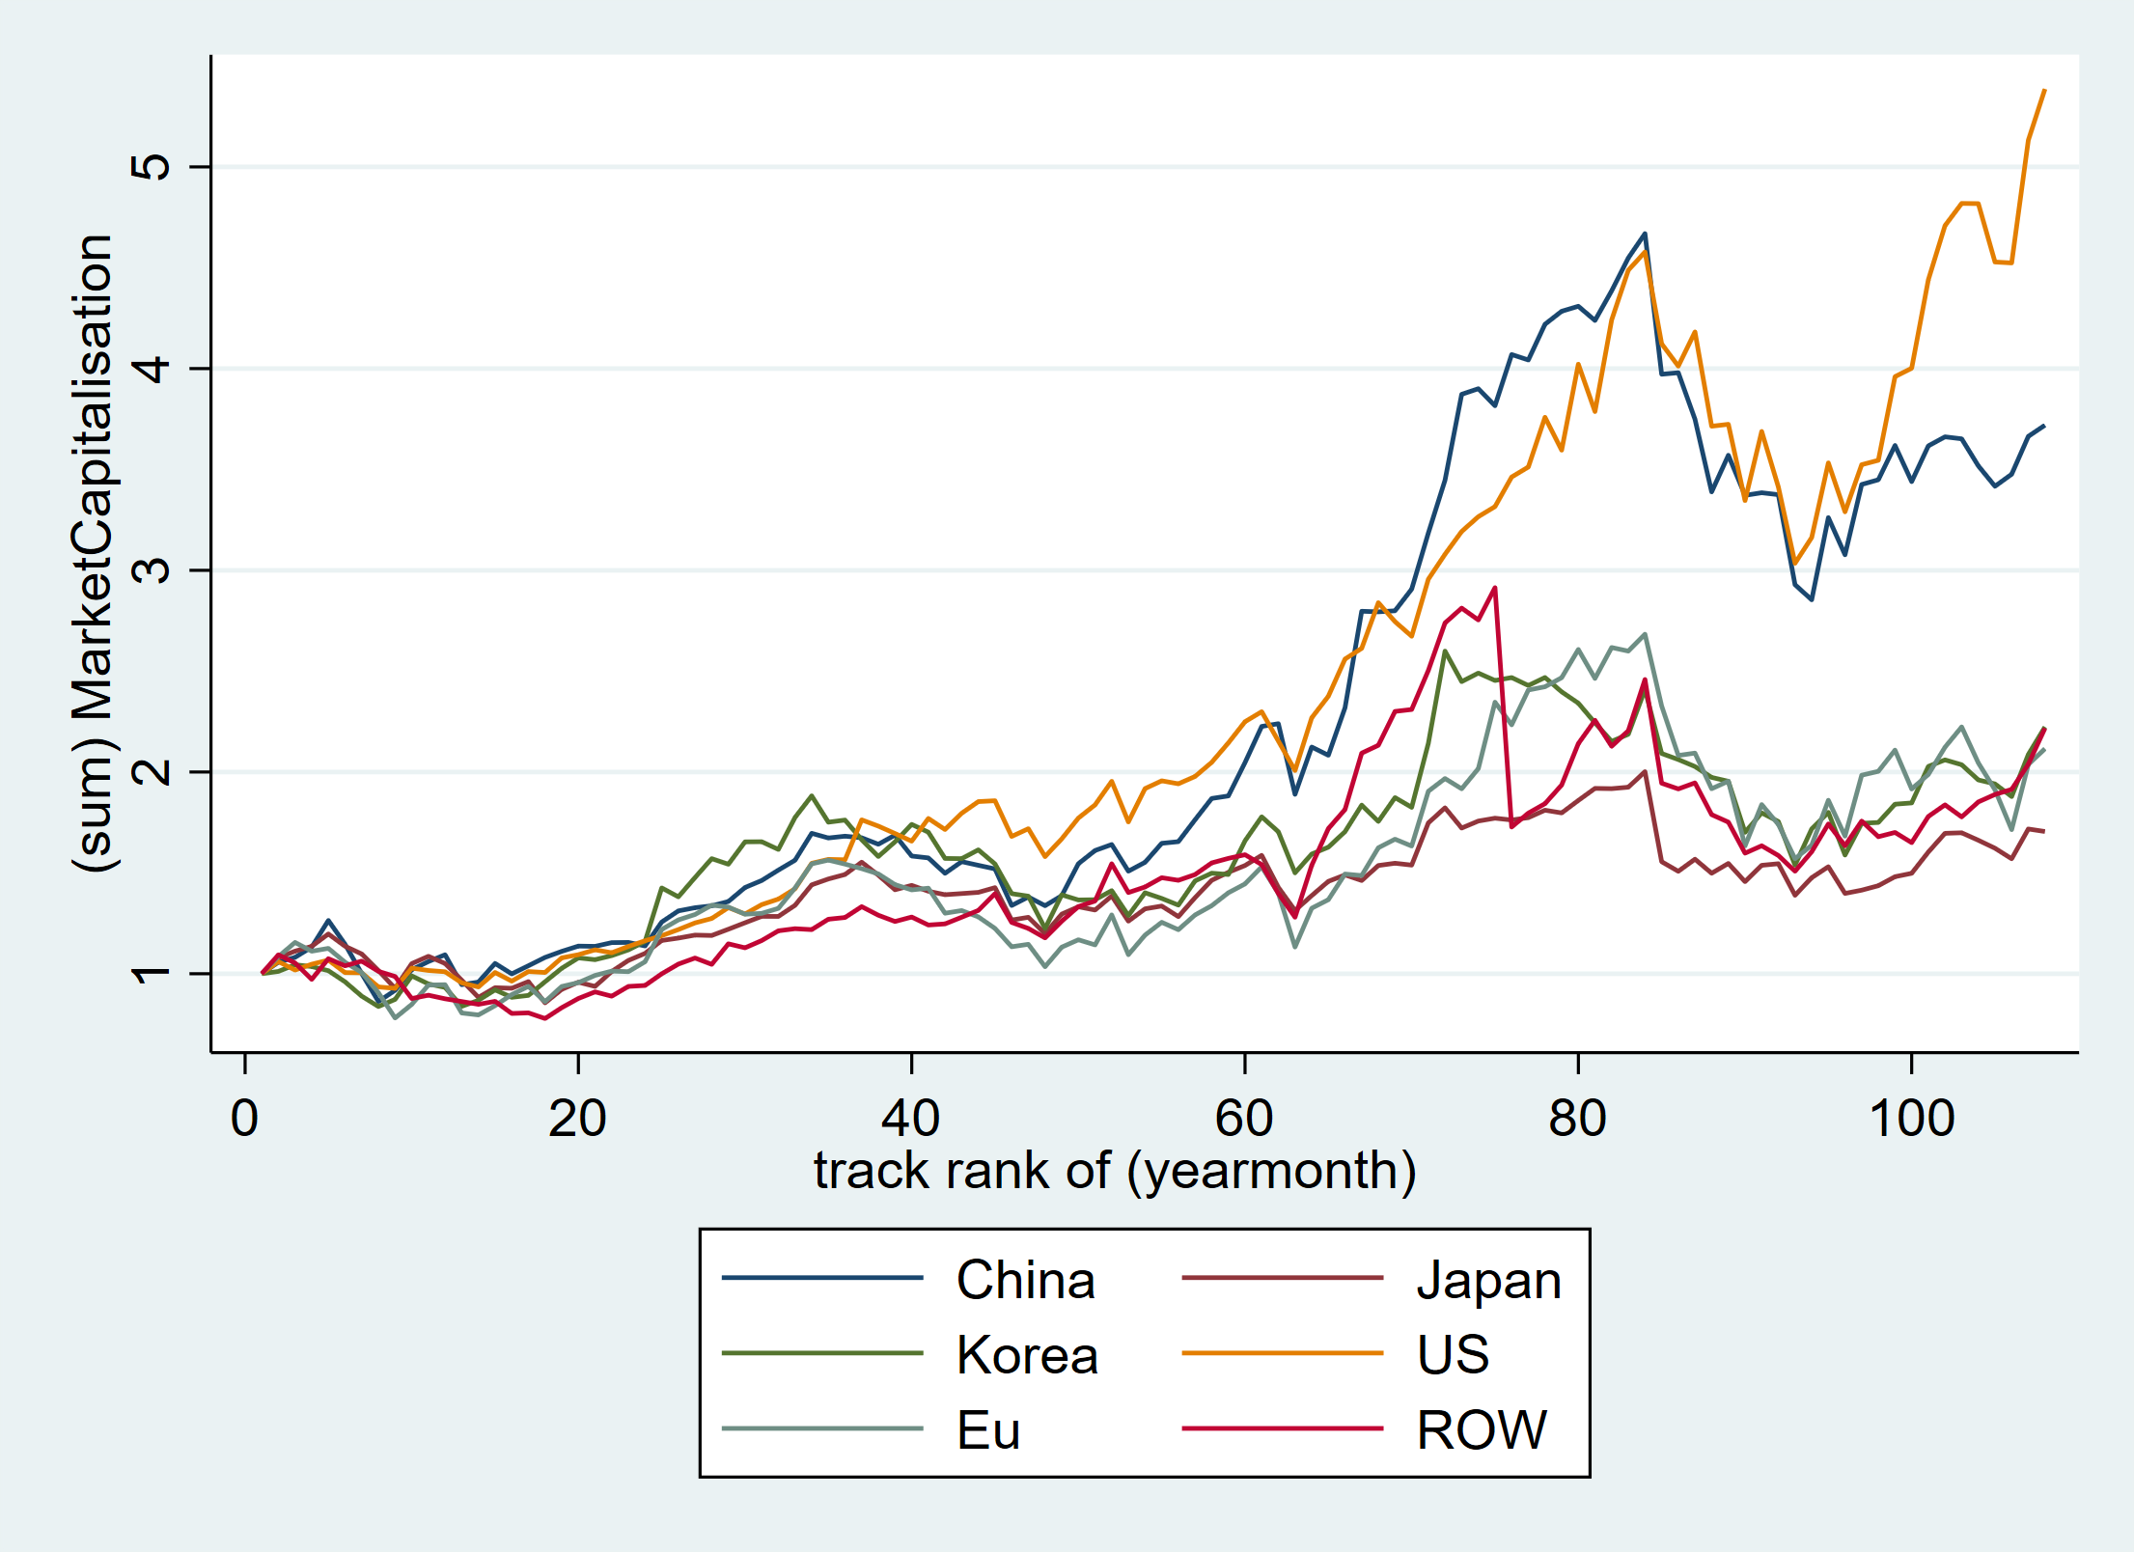
Semiconductor Firm MktCap
Source: ORBIS, firm list constructed by me

Slide 24
Trump 2.0 Trade

Slide 25
Trump 2.0 Trade

Slide 26
Trump 2.0 Trade

Slide 27
Trump 2.0 Trade

Slide 28
References
Caliendo, Lorenzo and Fernando Parro (2023) “Lessons from US–China Trade Relations,” Annual Review of Economics.
Ju, Jiandong (2025) Tsinghua UG Trade Class
Ma, Hong and Jingxin Ning (2024) “The return of protectionism: Prospects for Sino-US trade relations in the wake of the trade war,” China Economic Quarterly International.
Bown, Chad: PIIE Website

